Slide 1
Lecture 16
Machine Learning
COMP BIO

Slide 2
Announcements

Slide 3
Office hours again
Office hours this week
Tuesday 2-3
Wednesday 9:30-11:30
Wednesday 1:30-2:30
Thursday 4-5

Slide 4
Extra resources
David Nicholson- vak: neural network models for acoustic behavior | SciPy 2023
Messer Lab – SLiM

Slide 5
What is Machine Learning?

Slide 6
Machine learning
Machine learning (ML): artificial intelligence that seeks to learn patterns from data and generalize those patterns to new data
Or, extremely advanced statistics

Slide 7
Two main types of ML
Supervised machine learning: requires you to label your data so as to learn the patterns
This is most of what we will talk about in this class
Unsupervised machine learning: works from unlabeled data to learn patterns. Almost always clustering analyses
K-means clustering is an example

Slide 8
Types of machine learning algorithms
This is not an exhaustive list
Artificial neural networks (many types)
Bayesian statistics
Decision tree learning
Maximum entropy classifier
Nearest neighbor algorithm
Support vector machines
Random forests
Linear and logistic regressions

Slide 9
Machine learning in the real world
Recommendation algorithms
Image recognition
Alexa, Siri, Google Assistant
Suggestions for text messages/emails

Slide 10
Key ML Concepts

Slide 11
Training, Validation, and Testing
Training data: used to teach the model the patterns in your dataset, i.e., train parameters
Validation data: used to see how well your model is learning, i.e., train hyperparameters (more on this in a moment)
Testing data: used to see how well your final model actually works

Slide 12
Training, Validation, and Testing
Train an algorithm to distinguish between circles and squares

Slide 13
Training, Validation, and Testing
Note: 80-10-10 is a common way to split these data, but it’s more complicated than this
80% of your data are set to training
10% to validation
10% to testing
Train
Validate
Test

Slide 14
Training, Validation, and Testing
Cross-validation can also be used so that you have a combined training-validation dataset
Test

Slide 15
Training, Validation, and Testing
You need to make sure when you split things into your training/validation/test datasets, you do so in a balanced way.
Here: split squares, circles, and triangles.

Slide 16
Training, Validation, and Testing
What’s wrong with this set of splits?

Slide 17
Training, Validation, and Testing
Another: you want to build a machine learning model to predict how tall a plant will grow. Plants vary in fertilizer levels and temperature.

Slide 18
Training, Validation, and Testing
What’s wrong with this set of splits?

Slide 19
Training, Validation, and Testing
Another important consideration:
Overrepresented and underrepresented classes

Slide 20
Training, Validation, and Testing
A machine learning algorithm that learns to guess “square” 100% of the time on this dataset will be right 8/10 times

Slide 21
Training, Validation, and Testing
One way to fix this if you have enough data: as best as you can, make each class have the same number of observations

Slide 22
Training, Validation, and Testing
Parameters in an ML model are the relationships between your input data and your output data
Hyperparameters in an ML model are how the model itself is set up to learn

Slide 23
Training, Validation, and Testing
Comparing two linear regression models:
 | y = A*x | y = A*x + B*x²
Input data | x | x
Output data | y | y
Parameters | A | A, B
Hyperparameters | Linear | Linear, Quadratic

Slide 24
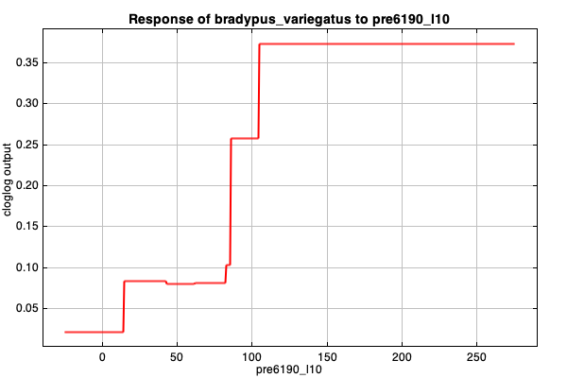
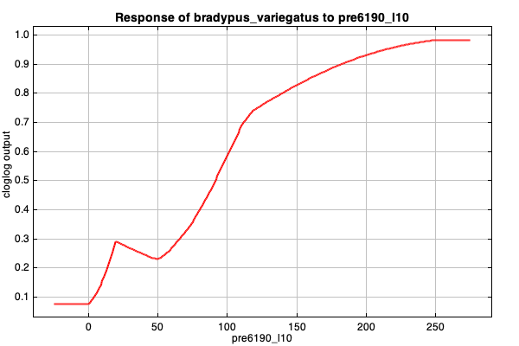
Training, Validation, and Testing
Hyperparameters are in Maxent too!
Threshold
Hinge

Slide 25
Overfitting of models
Maxent is an ML model after all
Also: machine learning models can be overfit just like we talked about with SDMs!

Slide 26
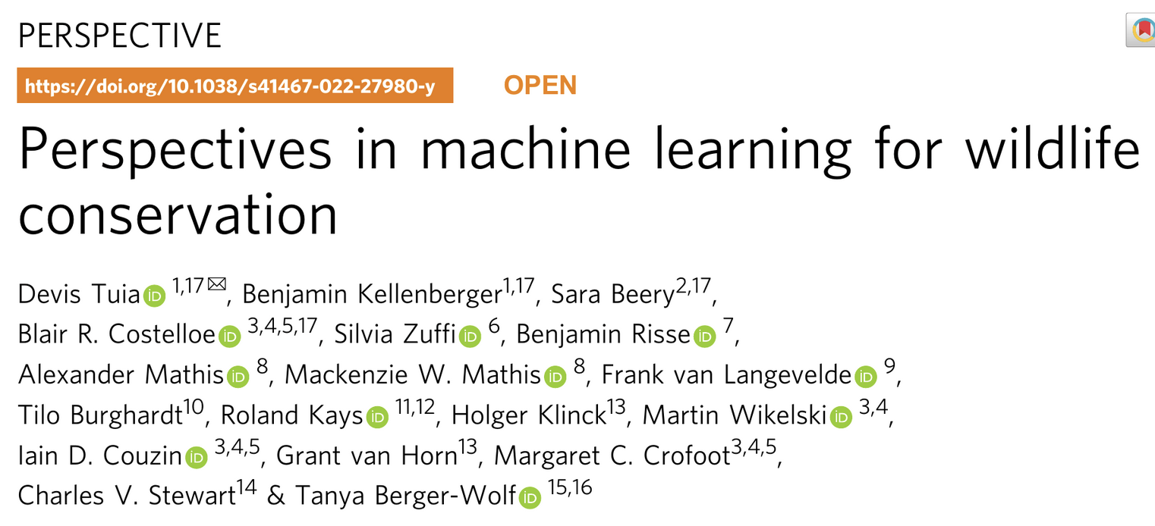
Your reading today

Slide 27
Artificial Neural Networks

Slide 28
Neural Networks
Artificial neural networks (ANNs, or NNs for short): a mathematical machine learning model that is based on the neurons in our brains.
Major subtypes: convolutional (CNNs) and recurrent (RNNs).
These form “deep machine learning”, which powers most of the AI related things in our lives today.

Slide 29
Solve complex mathematical problems
For x = 4, y = 6
For x = 1, y = 3
M = 1
B = 2
y = M*x + B
y
8
7
6
5
4
3
2
1
0
Learned from the x and y data!
0
1
2
3
4
5
6
7
8
x
Notes:
The learning part of machine learning comes into play when we do things like this. We learned what M and B were by using the data we had for X and Y. But this is just a linear regression, simple algebra. Machine learning can solve way more complex problems than that. Let’s see how.

Slide 30
Solve complex mathematical problems
x*M + 1*B = y
1
B
y
M
x
Notes:
Now we can represent this function ike a very basic neural network, which looks like this. I’m going to explain each part of this diagram.

Slide 31
Solve complex mathematical problems
x*M + 1*B = y
Input Nodes
Output Node
1
B
y
M
x
Circles = Nodes = Variables
Notes:
These circles are called nodes. Nodes are the variables in our function, and I have highlighted them.

Slide 32
Solve complex mathematical problems
x*M + 1*B = y
Input Nodes
Output Node
1
B
y
M
x
Arrows = Weights = Coefficients
Notes:
The arrows in this function are called “weights”. They are the same as the coefficients we multiply in the function.

Slide 33
Solve complex mathematical problems
x*M + 1*B = y
Input Nodes
Output Node
1
2
6;3
1
4;1
Notes:
So if b = 2, m = 1, and x =4 like before, we can do the math to get y=6.

Slide 34
Solve complex mathematical problems
x*M + z*N + 1*B = y
Input Nodes
1
Output Node
B
x
M
y
N
z
Notes:
It looks like this! We’ve added this z node and n weight to the bottom.

Slide 35
Solve complex mathematical problems
Input Nodes
Output Node
x
z
Hidden Node
Notes:
In machine learning, we call this a “hidden node” because we don’t see the value at that node usually. We just see the input and the output.

Slide 36
Solve complex mathematical problems
(x*M) + (z*N) = x₁
x₁*Q +1*B = y
Input Nodes
1
Output Node
B
x
y
M
Q
x₁
N
z
Learned from the x, z, and y data!
Hidden Node
Notes:
And again, to really hammer it in, these weights on the arrows will get learned from the x, y, and z data.

Slide 37
Solve complex mathematical problems
Input Nodes
Hidden Node
Output Node
Notes:
We can make these equations more complicated by adding more weights, so more things that we multiply.

Slide 38
Solve complex mathematical problems
Input Nodes
Hidden Nodes
Output Node
Notes:
We can add more nodes to any of the layers.

Slide 39
Solve complex mathematical problems
Input Nodes
Hidden Nodes
Output Node
Notes:
We can even add more layers! So here instead of having one layer of hidden nodes, we now have three layers, making the equations we can do more complicated.

Slide 40
An Example with Sound

Slide 41
Spectrograms
Spectrogram: a graphic representation of sound through time, where the x-axis represents time, the y-axis represents frequency, and the z-axis (or color) represents pressure amplitude
Not to be confused with waveforms: a graphic representation of the properties of sound as a wave, including wavelength and pressure amplitude through time
Spectrograms are calculated from waveforms

Slide 42
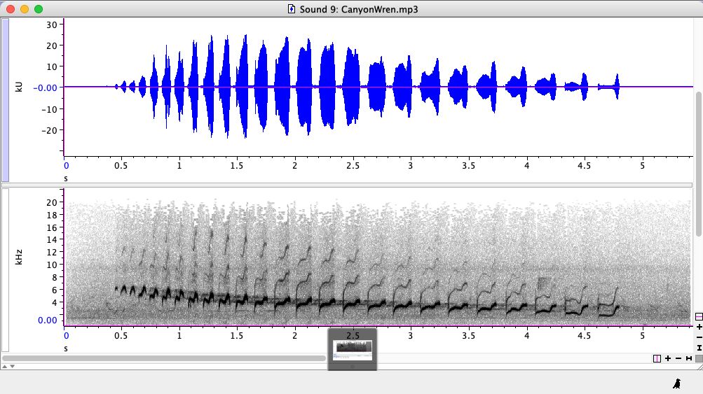
Example spectrogram and waveform
Waveform
Spectrogram

Slide 43
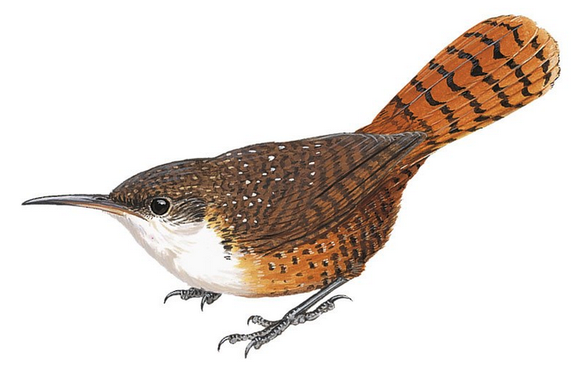

Example spectrogram and waveform
Canyon Wren
Catherpes mexicanus

Slide 44
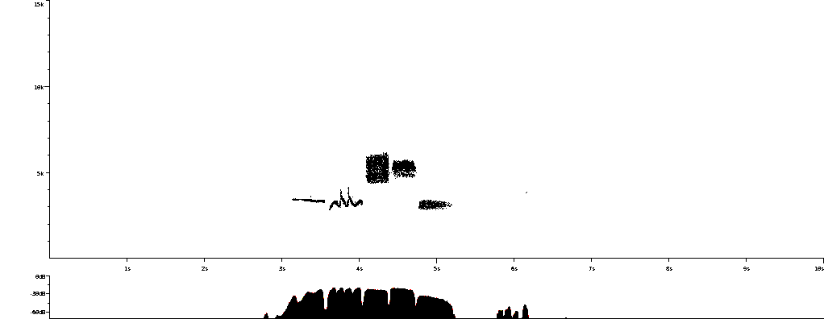
Labeling syllables to analyze songs
Spectrogram with Syllables
Frequency
Summary Statistics
Bandwidth
Duration
Frequency
Slope
Inflections
Time
Our Dataset: N = 513,617 syllables
Estimated total syllables: ~375 million
Notes:
In our dataset, we have over 500 thousand syllables to use and analyze, and extrapolating from our dataset ther’s up to 375 million syllables. That’s an astronomical number! And it poses a problem.

Slide 45

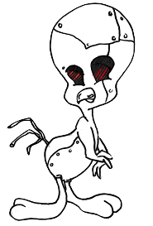
Automatic labeling is extremely efficient
Provost, Yang*, Carstens 2022, PLOS ONE; Cohen et al. 2022, eLife
Manual labeling: 4 seconds / syllable
Our Dataset: 570 hours
All birds: 15+ years
Automatic labeling: ???
Our Dataset: ???
All birds: ???
Notes:
However, in the last few decades automatic labeling procedures have become a lot more common to try and mitigate this time sink. In short, we decided to use a machine learning framework called TweetyNet which takes in our manual labels and our spectrograms, learns what syllables look like, and then labels predicted syllables.

Slide 46
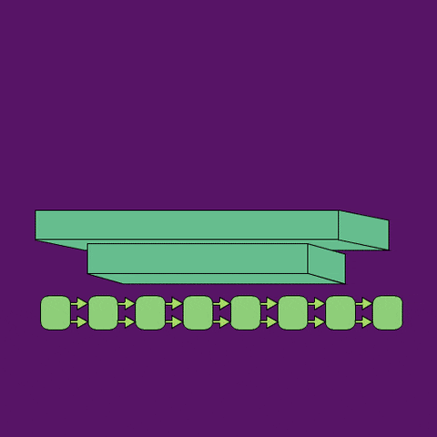
Automatic labeling is extremely efficient
Cohen et al. 2022, eLife; Provost et al. 2022, PLOS ONE
Input: Image of Song (Spectrogram)
Hidden Nodes
(cNN and rNN)
TweetyNet
Output: Location and Type of Parts of Song
(Syllables)
Notes:
This is a gif schematic of that procedure. I am not going to go into the heavy details, but essentially the program is given a spectogram, as an image. It then passes the image through a neural network with lots of hidden nodes, and finally it predicts where the syllables are.

Slide 47
Automatic labeling is extremely efficient
Provost, Yang*, Carstens 2022, PLOS ONE; Cohen et al. 2022, eLife
Manual labeling: 4 seconds / syllable
Our Dataset: 570 hours
All birds: 15+ years
Automatic labeling: 0.03 seconds / syllable
Our Dataset: 4 hours (+8 to train)
All birds: 6 weeks
Notes:
And it does that labeling orders of magnitude faster than a human can, at about 90% accuracy. With a fully trained tweetynet model, I can annotate all 500 thousand syllables in four hours on my laptop. For all birds, on my laptop, that would take about six weeks -- less time if we set it up on a supercomputer. Not only that, the automatic annotation is consistent and less qualitative than humans, so we can now work at SCALE when analyzing bird songs. So that’s excellent. B

Slide 48
How accurately can we process syllable data?
Provost et al. 2022, PLOS ONE
100%
100%
90%
90%
80%
80%
Accuracy
70%
70%
60%
60%
50%
50%
0
20
40
60
80
Close
Distant
Estimated Divergence (mya)
Phylogenetic Relatedness
Notes:
We can also bin this data -- so this is binning by taxonomic groups. The x-axis here is how closely or distantly related things are, with the different bars being order, suborder, family, and so on, down to genus and species. The y-axis is the same as the other plot. And the lines coming out of these bars are standard deviations.

Slide 49
Student-selected topics

